Slide 1
Native App Automated Testing Tools -The Good, the Bad and the Ugly
508
Date: March 21, 2018
Jatin Vaishnav – jatin@deque.com
Chris Mcmeeking – chris.mcmeeking@deque.com
AUDIT
ARIA
ADA
WCAG

Slide 2


Introductions
Jatin Vaishnav
jatin@deque.com
Senior Subject Matter Expert
Deque Systems Inc
Twitter: @1vjatin
Chris McMeeking
Chris.mcmeeking@deque.com
Accessibility Engineer
Deque Systems Inc
508
AUDIT
ARIA
ADA
WCAG

Slide 3
Agenda
What makes a good testing tool?
Automated testing tools
  Apple - iOS
    Accessibility Inspector (Xcode IDE tool)
  Google - Android
    Accessibility Scanner (Android App)
Deque’s Process
  Continuous integration
  How our tool fits

Slide 4
The Goal of Automated Testing
Find accessibility violations
Tool must be easy to use
Should provide detailed a11y API information
Have minimal Subject Matter Expert involvement
Accurate findings vs False positives
Remediation recommendation
Speed up the process of bug reporting

Slide 5
Judgment Criteria
WCAG 2.0 AA (2.1!)
Security / Privacy
Remediation recommendation
False positives
Developer centric (NO Subject Matter Expert Involvement)

Slide 6
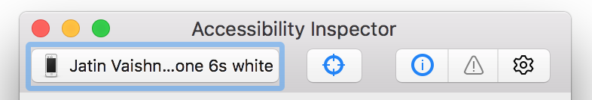
iOS Accessibility Inspector
Integrated with Xcode 8 Developer Tools
Features
  Accessibility Audit
  Inspection Modes
  Setting live preview
  Supported platforms
Target Chooser
Inspection
Settings
Inspection Pointer
Audit

Slide 7
iOS Accessibility Inspector - Demo
Category | Details | The Good | The Bad | The Ugly
Images | Informative images missing accessible name (accessibilityLabel) | ✅
Images | Active Images (link) missing accessible name | ✅
Headings | Text functions and styled like headings |  | ✅
Input | Text Field missing it’s associated accessible name | ✅
Touch Target | Touch Target Size too small (44 pt by 44 pt) | ✅
Dynamic Text | Dynamic Text font sizes |  |  | ✅
Reading order | Logical and Intuitive reading order |  | ✅
Data Table | Data cell’s association with column header &/or row header |  | ✅
Color Contrast | Text contrast ratio of 4.5 to 1 |  |  | ✅

Slide 8
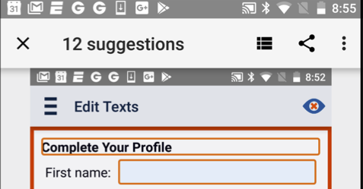
Android Accessibility Scanner
Features
  Accessibility Audit
  Suggest improvements such as
    Enlarging small touch target
    Increasing Contrast
    Providing content descriptions
  Screenshot of the UI with possible improvement
  Option to see full list of improvement
  Share results
Show results list
Share results
Delete

Slide 9
Android Accessibility Scanner - Features
Category | Details | The Good | The Bad | The Ugly
RuleSet | Material Design Guidelines are questionable from an Accessibility Perspective. Worse if your goal is compliance. |  | ✅ | ✅
Security | Storing reports with screen content on device is concerning. |  |  | ✅
Email Reports | Ability to email a report is pretty cool. | ✅
Self Contained | Runs completely self contained on device. (Compare to features available in iOS) | ✅
Developer Support | Espresso Library contains the same rules, though reliance on RoboLectric lessens value, and APIs for filtering rules are clunky. Remediation advice often misleading (compliance) |  | ✅

Slide 10
Deque’s Process - Continuous Integration
Rule sets built for developers
  No False Positives
  Detailed Remediation Advice
  Behavioral Descriptions (Developers learn accessibility as they use the tool)
Integrate Into Test Suite
  Simple APIs (one liners) that can be built into existing Unit or UI Tests
  Configure results consumers to fit your process
    EX: Ignore Color Contrast rules for a period of time to support design phase
    EX: Only fail builds for one category of issues
EVERY Release has a baseline level of Accessibility
  Save subject matter expert time and money

Slide 11
Overview Deque’s Tools (Continuous Integration)
Libraries dedicated to each platform
  Build into the platform the way developers would want
    iOS - Simple Framework that could be hosted as a CocoaPod or Carthage Dependency
    Android - Java/Android Library hosted from artifactory and included in build scripts
Additional Support for Manual Processes
  Get the same results from a running app by connecting via our desktop client(Android) or a browser (iOS)
  Subject Matter Experts/QA Engineers can look at the exact same reports the way they want to see them
Export Reports as Structured JSON
  Send results to issue trackers (JIRA) or reporting engines

Slide 12
Deque Accessibility Tools - Android
Category | Details | The Good | The Bad | The Ugly
RuleSet | Based on WCAG 2.0 (Looking forward to 2.1 as well). Also, generally overall better coverage than Android in general. | ✅
Security/Privacy | Reports via Desktop Client Utilizing HTTPS and SSH key | ✅
Email Reports | Not yet… but soon. |  |  | ✅
Self Contained | Runs completely self contained on device. |  | ✅
Developer Support | Simple APIs, easily filter and manipulate results, with remediation advice that can make a novice an expert (Dave Musser Story) | ✅

Slide 13
Q&A
Thank you!
Jatin Vaishnav
Deque Systems Inc
jatin@deque.com
Twitter: @1vjatin
Chris McMeeking
Deque Systems Inc
chris.mcmeeking@deque.com

